Slide 1
Class of 2027
INTRODUCTION to the
THIRD YEAR
Monday, January 13th, 2025
SSOM/Cuneo 190
Office of Student Affairs
Stritch School of Medicine

Slide 2
session goals
To de-mystify the process of clinical scheduling
To discuss 3rd year clerkship requirements & options
To build positive anticipation
To allow you to plan

Slide 3
objectives
To describe the clinical calendar
To explain the Clerkship Track System (CTS) for 3rd year
To review the track assignment process
To give you some guidance on ranking tracks
To provide an overview of the site assignment process

Slide 4
Today’s session
NOT intended to prepare you for your role and responsibilities as a junior clerk
NOT intended to tell you what to expect on the floor

Slide 5
Handout contents Forthcoming
Calendar of Important Events/Dates
CTS General Info
Chart of M3 Clerkship Tracks
M3 Calendar
M3 Elective Options
Elective Opening Registration Dates

Slide 6
Third year calendar
Three terms (Summer, Fall, Spring)
One-week break in fall semester (Track A & B breaks vary)
Winter/Holiday break is Saturday, 12/20/25 – Sunday, 1/4/26
Participation in clerkships on Day 1 (Orientation) and Final Exam Date are MANDATORY (Plan travel accordingly)

Slide 7
First week of Year three
Monday, April 28 – Friday, May 2
    3rd Year Orientation/Clinical Skills Workshops
    PCM-3 Day (Friday 5/2)
      Attendance required
      You must sit for Step 1 no later than Sunday, April 27, 2025.
      If you don’t sit by April 27th, the start of your clerkships will have to be delayed.
Monday, May 5: Clerkships begin
      Attendance required

Slide 8
CLERKSHIP TRACK SYSTEM (cts) General info
Third Yr CTS governs the order students take their required clerkships
Tracks assigned via a lottery process
Changes possible but very limited
CTS does NOT include site placement

Slide 9
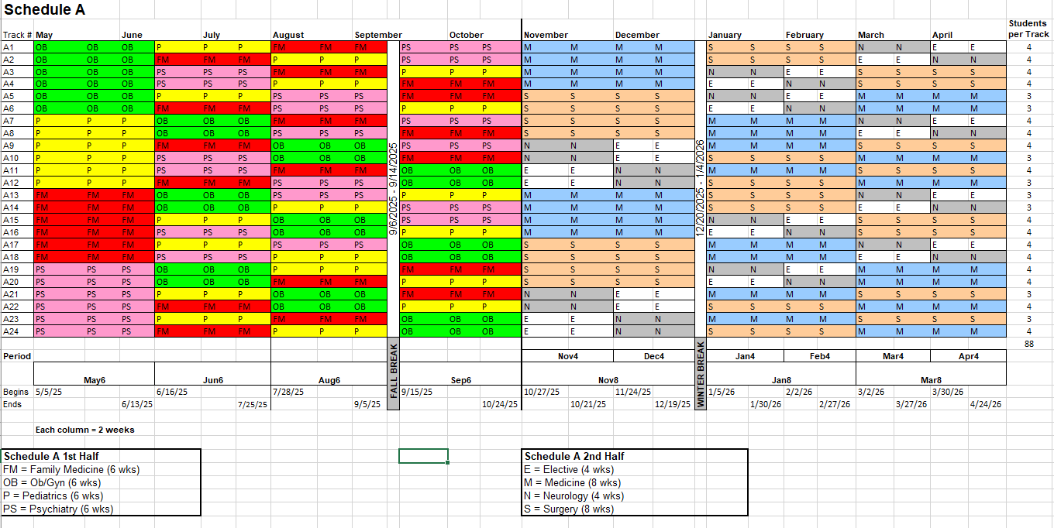
CTS: schedule a- 2025-2026

Slide 10
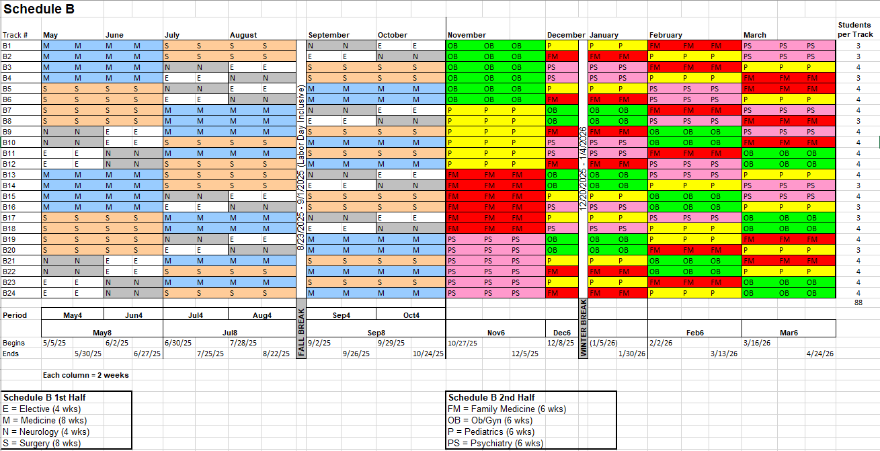
CTS: schedule B- 2025-2026

Slide 11
CTS features
Starts with orientation & a clinical skills workshop course prior to clerkship start
Two track schedules (A & B), 24 tracks per schedule permit randomized sequence across clerkships
3-4 Students per track: permits enrollment to be distributed evenly

Slide 12
Third year core clerkship requirements
  Medicine - 8 wks
  Surgery – 8 wks
  Neurology – 4 wks
  Elective – 4 wks
  Family Med – 6 wks
  OB/Gyn – 6 wks
  Pediatrics – 6 wks
  Psychiatry – 6 wks

Slide 13
Required clerkship sequencing
Any core clerkship may occur first
None are prerequisite to any other
Sequencing not directed toward specific career paths
Each track guarantees all core clerkships

Slide 14
Third year elective options
Limited to certain clinical specialties or research experiences
Additional details later in program

Slide 15
Other Third year requirements
PCM-3 Seminars (only 9 sessions throughout year, dates on academic calendar)
  Representative Topics (subject to change):
    Business, Professionalism & Justice
    Inter-professional teamwork
    Global Health
    End of Life Care I & II
    Ethics and Professionalism
    The Opioid Epidemic
    Comprehensive Patient Care: Nutrition and Prevention/Screening/Nutrition Expo
    Caring for and With our Immigrant Neighbors
    Becoming the Third Year Medical Student You Want to Be
Please note, students are allowed up to two excused absences for PCM-3. A third absence will result in automatic failure of the course, which would require repeating the course again in its entirety.
We try to make the afternoons yours, to use as personal time.

Slide 16
Other Third year requirements (CONTINUED)
  TCM-3 (Topics in Clinical Medicine – aka vertical curriculum)
  End of Life
  Point of Care Ultrasound
  Radiology
  Comprehensive year-end exam
  End-of-life OSCE
  Medical Humanities
  Ethics Grand Rounds (four required for graduation)
  Ethics Case Paper (due in spring of 3rd yr)

Slide 17
CTS LOTTERY RULES AND PROCESS
Lottery numbers are computer generated at random.
You cannot sell or trade your number!
Track ranking form will be on myLUMEN.
Lottery numbers will be found in myLUMEN and will be available later this week.
Track Rank Form is due by Monday, 1/27/25 at 9 AM.

Slide 18
CTS LOTTERY RULES AND PROCESS (CONTINUED)
Once the track assignment is completed, trading of complete tracks or individual clerkships is allowed for a limited time - see “CTS General Info” for rules
Changes in sequence also may be possible by petition to Reg. & Records

Slide 19
RANKING TRACKS
Different tracks fit different individuals’ needs.
You can do well in any track.
Every core Dept. is prepared for rookies.
All UG trainees (medical students) are new in May; All Grad (residents) trainees are new in July.
Clinical skills & knowledge are evaluated on sliding scale during the year.

Slide 20
RANKING TRACKS (CONTINUED)
SUMMER: You’re learning the ropes.
    You can do well on any track.
FALL & WINTER: Work well for interest areas.
SPRING: Planning for fourth year electives starts; performance should show solid growth & ability

Slide 21
You might consider…
The ebb and flow of rigor & type of work
More challenging/more inspiring sequencing
With whom do you study/share study resources
Personal issues (partner’s schedule, commitments)
Avoiding crowd mentality about “perfect” tracks
Talking to your advisor
Talk to OSA deans

Slide 22
Myth: there are easier/harder rotations
REALITY:
It differs by season (everything may be difficult in the summer).
It differs by site, patient load, acuity level.
It differs because of team work ethic & style.
It differs by your own motivation & what you put into each clerkship.
It differs because attendings and residents change each year.
It differs by your own life experiences.

Slide 23
GOOD ADVICE:
Be prepared to make the most of every rotation - even those that seem sub-optimal.
Plan to stay focused and involved every month - you can’t turn commitment and enthusiasm on/off during 3rd yr and be successful.
Don’t pick a track around potential vacations or good weather activities.

Slide 24
FOCUS ON THE “BIG PICTURE”
The track sequence is NOT critical.
Don’t get hung up about when every clerkship falls.
Pick one or two key points relevant and important to your own needs and work those features into your top track picks.

Slide 25
SPECIAL SITUATIONS TO CONSIDER
Contact Dean Mendez or Dean Zarco if you are:
in the military scholarship program
anticipating a Year 2 remediation schedule
dealing with other significant academic commitments or concerns
attempting to juggle personal priorities and school
seeking to transfer to another school
Faculty advisors & SAS advisors are good resources for advice.

Slide 26
Site assignment process
Clerkships must be taken at sites specified by SSOM.
Sites assigned by lottery:
  Surgery, Neuro, Peds, Psych, Family Med (except sites requiring Spanish fluency)
Assignments made by placement:
  OB/GYN, Medicine
TRACK LOTTERY NUMBER DOES NOT APPLY TO SITE LOTTERIES.

Slide 27
Site assignments (Continued)
Students submit site preference; once made, assignments are BINDING.
Subsequent lotteries occur about 4 - 6 weeks prior to start of each clerkship.
Follow policies governing site placements (provided by your clerkship coordinator).
If placed at Hines VA, follow instructions and complete any onboarding requirements well in advance.

Slide 28
Site assignments (continued)
You will need good, reliable personal transportation. Your daily schedule may not permit carpooling.
Your decrepit, rusted out, 2014 car with four bald tires will not exempt you from being assigned to more distant sites.

Slide 29
Site requirements (continued)
Your immunizations must be current.
  This includes Heptavax completed and titer drawn
  TB must be current
  Other requirements per site
Drug screening is required before the start of the M3 year. This is MANDATORY! You will receive additional information about this from Student Life (Catherine Jardien).
Criminal Background Check may be required (student pays).

Slide 30
Third year elective option
Purpose: to offer exposure to certain specialties or subspecialties for students considering these disciplines as a career.
Pay attention to elective prerequisites when selecting your preferred track and elective.
Also note when electives are available; some are not offered year-round.
See list of elective options in packet forthcoming; course descriptions online in SSOM Elective Catalog.
Timetable for when to register in handout forthcoming; and how to register to follow.

Slide 31
Florida Sites Overview

Slide 32
Clerkships
Pediatrics – 5 weeks – Fort Myers – 2 students
OB/GYNE– 5 weeks – Fort Myers – 2 students
Internal Medicine – 3-4 weeks – Naples – 1 student
Opportunity created based on student feedback regarding overcrowding during required clinical clerkships and suboptimal exposure to the wide variety of patients. These are high volume sites carefully selected to provide improved experience for students.

Slide 33
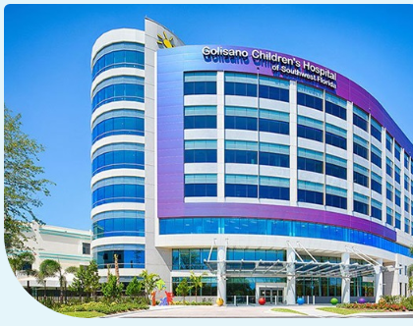
Pediatrics and OB/GYNE
Lee Health System in Fort Myers, Florida
Large stand-alone children’s hospital and attached destination center for obstetric care

Slide 34
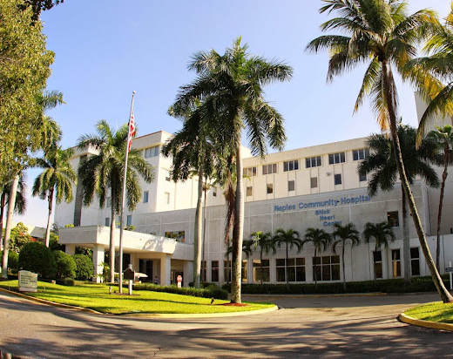
Internal Medicine
Naples Community Healthcare System

Slide 35
Travel stipend provided to either fly or drive to Florida
Fully furnished apartment with amenities available
Naples hospital within walking distance and stipend covers rental car/uber in Fort Myers if personal vehicle not used
Didactic content provided via zoom in addition to local educational conferences and skills sessions
Return to main campus for OSCE and NBME shelf exam in final week of clerkship

Slide 36
Selection Process
Once you receive your tracks you will receive survey regarding your desire to travel to Florida for any of the available clerkships
If you feel you are unable to travel then you will need to indicate on survey and meet with Student Affairs
If all of the spots are not filled then a lottery will take place and you will be assigned a specific lottery number related to placement at a Florida site

Slide 37
Questions
Reach out to Dr. Adam Kabaker, Assistant Dean for Clinical Development
akabaker@lumc.edu

Slide 38
Student Feedback
“Incredible diversity of patient cases”
“Great teaching faculty, along with great enthusiastic residents”
“The sim lab is really brilliant”
“Both the patient demographics and staff demographics were more diverse than Loyola”
“I felt I was able to see more deliveries and surgical cases than my peers who rotated back in Chicago”

Slide 39
“Living conditions were top notch”
“Beach is amazing”
“Naples is considered the capital of pickleball”

Slide 40
Other Important Information

Slide 41
Important info to note:
Day one on each clerkship is crucial.
Exams must be taken at their assigned time.
  No exceptions (Christmas cheap airfare dates included!)
Exam times float – may be in A.M. or P.M.
Sat/Sun attendance may be expected on some services at some sites (i.e., 6-day work week).

Slide 42
Important info to note (continued):
Daily attendance in year 3 & 4 is MANDATORY
Unexpected/Emergency Absences from Required Activities
  During Year 3 and Year 4, any unexpected absence due to illness or other serious emergency requires
  prompt notification by the student to the Associate Dean for Student Affairs or designee and to the
  Course/Clerkship/Elective Director. This notification constitutes a request for an excused absence due to a
  legitimate extenuating reason. The Office of Student Affairs alerts the course/clerkship/elective department
  and/or director of the absence if the student is unable to do so.
  Examinations or other required academic activities that are missed may be made up only if the Associate
  Dean for Student Affairs or designee has granted permission for the absence. Please note: Illness requires
  written documentation from the Wellness Center.
  Contact the following:
    Site team leader
    Clerkship director
    Clerkship coordinator
    Copy: Dean Mendez or Dean Zarco

Slide 43
Important info to note (continued):
Non-Emergent Absences from Required Activities
  Petitions for approved absences for non-emergent reasons are reviewed by the Course/Clerkship/Elective Director and/or Coordinator, and a decision is made to approve the request or not. In some cases, the Associate Dean for Student Affairs or designee may be consulted before a decision is made. The student must have a serious reason for an excused absence in Year 3 and Year 4 (e.g., wedding of a sibling or research presentation). Should a student have a serious reason for requesting to be absent for one to two days, a written petition must be submitted at least 30 days prior to the start of the course/clerkship/elective in which the absence would occur.
  The petition detailing the nature of the conflict should be sent to both the Course/Clerkship/Elective
  Director and the Coordinator. Supporting documentation should be attached (e.g., copy of a jury summons) to the petition, which requires review and is not automatically approved simply by submission. By notifying the relevant school offices at least 30 days in advance of the start of the rotation, the student’s clerkship specialty service and call schedule is considered and adjusted to minimize the effect of any days excused. The student is notified of the decision by the Course/Clerkship/Elective Director or the course coordinator. Non-emergency absences not requested at least 30 days in advance of the start of the clinical
  course cannot be accommodated.
  Contact the following:
    Clerkship director
    Clerkship coordinator
    Copy: Dean Mendez or Dean Zarco

Slide 44
Important info to note (continued):
Third-year clerks will need both long and short white coats worn according to the service assignment.
The Office of Student Affairs will provide you with a new long white coat.
If you need to purchase a new coat, please contact Student Life, Catherine Jardien.

Slide 45
Important information to look out for
Email containing today’s handout & presentation
Track lottery information
Site assignment procedures (after tracks have been assigned)
List of Course Directors and Staff, sites, specialty services.

Slide 46
Important dates
Track Ranking Due Monday, Jan. 27th (look for email instructions)
Tracks assigned by early-February
First elective registration date Feb. 16th (for May electives only)
  Students can submit their requests and coordinators can begin approvals on Monday morning.
Submit site choices (if applicable) for May Clerkship (continue to check SSOM email!)

Slide 47
Important dates (Continued)
Monday, April 28 – Friday, May 2
  M3 Orientation/Clinical Skills Workshops/PCM-3
  Attendance required
  Homework will be required to be done in advance
Monday, May 5
  Clerkships start (Attendance required)
  Please note: You are required to sit for Step 1 no later than Sunday, April 27, 2025

Slide 48
Questions?
For advice/suggestions: Consult your faculty advisors and/or Office of Student Affairs
Best wishes as you plan for year three!
Office of Student Affairs

